Slide 1

by:
Roberto Russo & Flaviano Testa

Slide 2
The Idea
MyUniLife is the University Advisor (with its mobile app) that will help the academic people in their university lives (f.e. to find an accommodation, to pass an exam, participate in events).
The platform is built to help students navigate through university life, have productive learning experiences and an entertaining university environment.

Slide 3
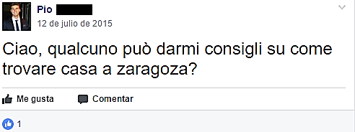
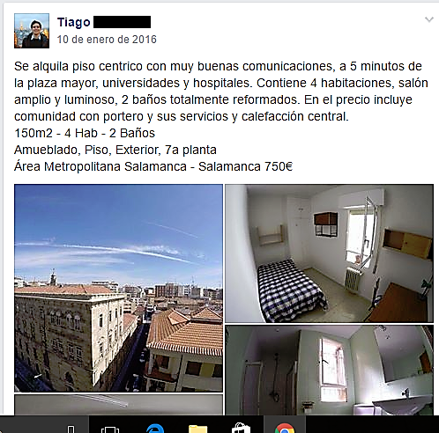
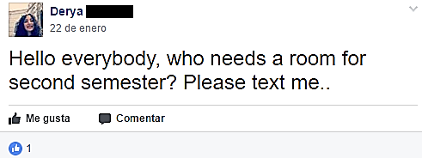
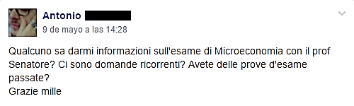
Problem

Slide 4
Solution
• UNIVERSITY ADVISOR: support for the student for the university choices and during their University Career (Erasmus, Internship) through a rating system, reviews, pictures and tips about the Universuty and faculties from all over the world;
• publication and consultation of housing announcements that meet the needs of the students through a review system of previous users;
• offer of educational material and notes useful for passing exams.

Slide 5
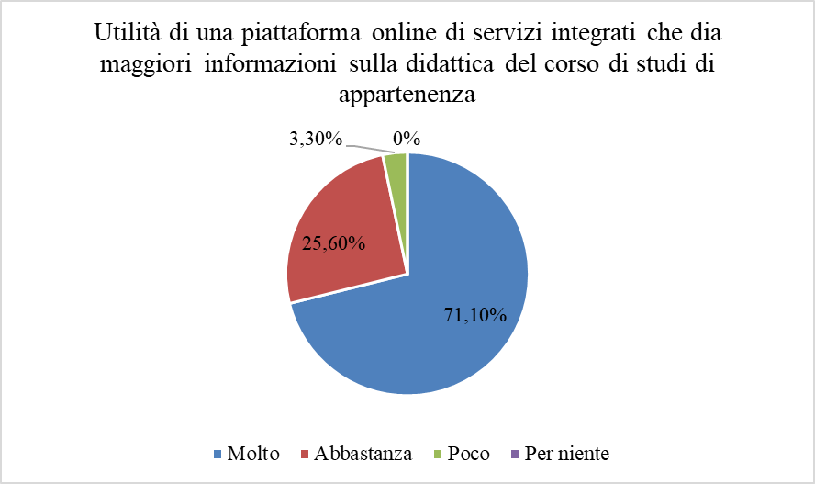
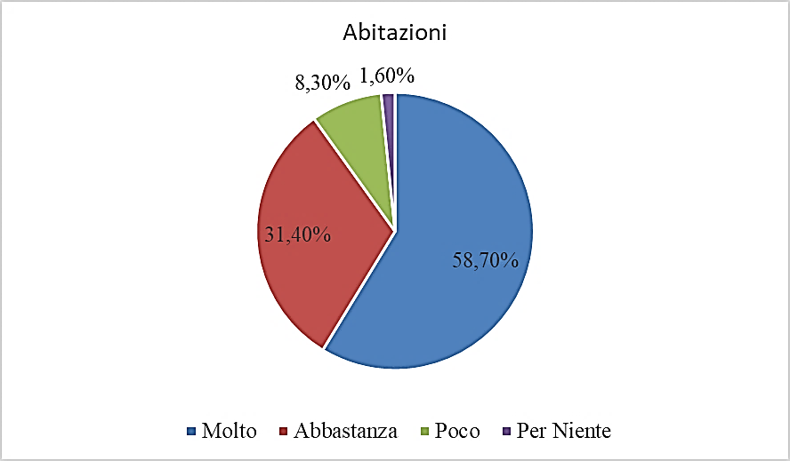




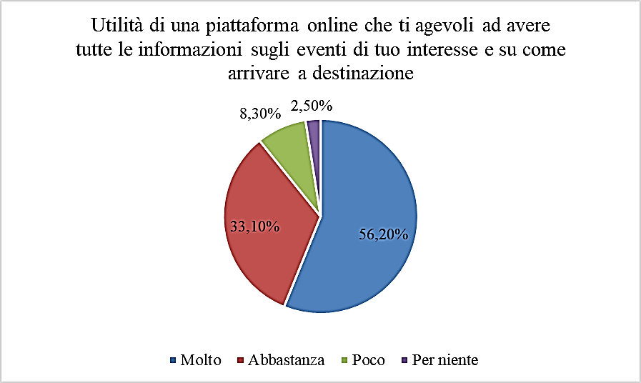
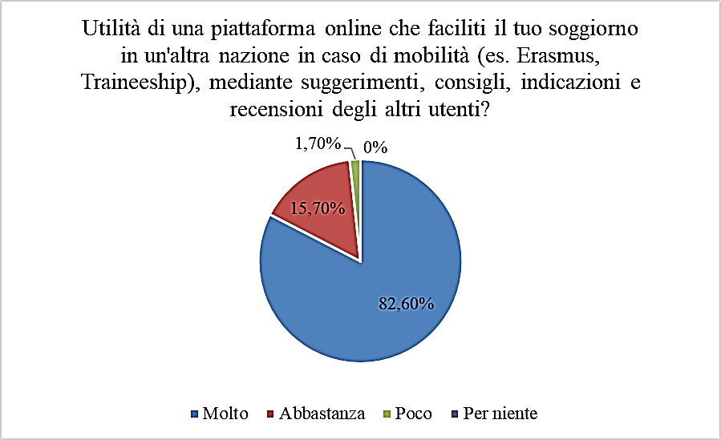

Market Analysis*
* Sample: 200 Students
Learning Information
Housing
A lot
Quite a lot
Not at all
Event Advertising
International Mobility
Slightly

Slide 6



SWAT and Competiton Analysis

Slide 7
Economic Plan*
YEAR | 1 | 2 | 3
Freemium Students | 1800 | 2700 | 3600
Freemium Revenues | € 21.384,00 | € 32.076,00 | € 42.768,00
Housing Announcments | 40 | 60 | 70
Announcment Price | € 1,00 | € 1,00 | € 1,00
Announcment Days | 180 | 200 | 220
Announcment Revenues | € 7.200,00 | € 12.000,00 | € 15.400,00
TOTAL REVENUES | € 28.584,00 | € 44.076,00 | € 58.168,00
HR Cost | € 0,00 | € 0,00 | € 0,00
Development web site | € 15.000,00 | € 10.000,00 | € 5.000,00
Advertising and marketing | € 10.000,00 | € 7.000,00 | € 5.000,00
VARIABLE COSTS | € 25.000,00 | € 17.000,00 | € 10.000,00
Gross Operating Margin | € 3.584,00 | € 27.076,00 | € 48.168,00
Company Foundation | € 1.819,87 | € 637,47 | € 637,47
Trademark registration | € 136,00 | € 0,00 | € 0,00
Equipment | € 1.300,00 | € 0,00 | € 0,00
Rents | € 3.600,00 | € 3.600,00 | € 3.600,00
Consumables | € 65,00 | € 65,00 | € 65,00
Utilities bills | € 1.770,00 | € 1.770,00 | € 1.770,00
Consulting | € 2.818,20 | € 2.818,20 | € 2.818,20
FIXED COSTS | € 11.509,07 | € 3.455,67 | € 3.455,67
GROSS PROFIT (LOSS) | -€ 7.925,07 | € 23.620,33 | € 44.712,33
IRES taxes | € 0,00 | € 5.688,88 | € 10.730,96
IRAP taxes | € 178,12 | € 1.345,68 | € 2.393,95
NET PROFIT (LOSS) | -€ 8.103,19 | € 16.585,77 | € 31.587,42
*sample: 1 Italian University

Slide 8
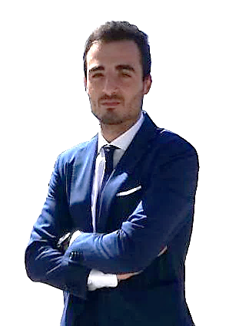
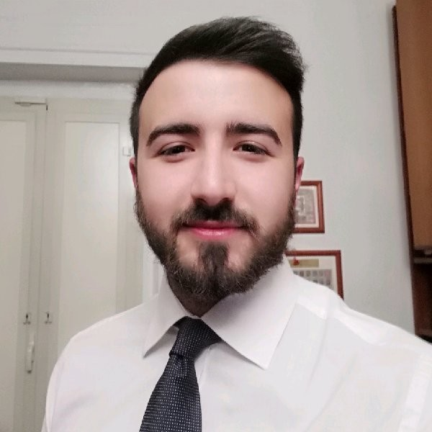
TEAM
FLAVIANO TESTA
CFO & Founder
25 Years old, graduated in Economics and Finance. Erasmus Traineeship at the InterAnalysis Ltd (UK). Now working at EY S.p.A. Italy
ROBERTO RUSSO
CEO & Founder
26 Years old, Personal Banker, master's degree in Consulting and Business Management at University of Salerno. Erasmus in Salamanca, startupper, traveler.

Slide 9

Thanks for your attention

